Slide 1
Cipher Techniques: Substitution and Transposition
-Before computers, cryptography consisted of character-based algorithms.
-Different cryptographic algorithms either substituted characters for one another or transposed characters with one another.
-The better algorithms did both, many times each.
-Things are more complex these days, but the philosophy remains the same.
The primary change is that algorithms work on bits instead of characters.
This is actually just a change in the alphabet size:
from 26 elements to two elements.
-Most good cryptographic algorithms still combine elements of substitution and transposition.

Slide 2
Substitution Ciphers
-A substitution cipher is one in which each character in the plaintext is substituted for another character in the ciphertext.
The receiver inverts the substitution on the ciphertext to recover the plaintext.
In classical cryptography, there are four types of substitution ciphers:
— A simple substitution cipher, or monoalphabetic cipher, is one in which each character of the plaintext is replaced with a corresponding character of ciphertext. The cryptograms in newspapers are simple substitution ciphers.
— A homophonic substitution cipher is like a simple substitution cryptosystem, except a single character of plaintext can map to one of several characters of ciphertext.

Slide 3
For example,
“A” could correspond to either 5, 13, 25, or 56, “B” could correspond to either 7, 19, 31, or 42, and so on.
-A polygram substitution cipher is one in which blocks of characters are encrypted in groups.
For example, “ABA” could correspond to “RTQ,” “ABB” could correspond to “SLL,” and so on.
— A polyalphabetic substitution cipher is made up of multiple simple substitution ciphers.
For example, there might be five different simple substitution ciphers used; the particular one
used changes with the position of each character of the plaintext.

Slide 4
The famous Caesar Cipher, in which each plaintext character is replaced by the character three to the right modulo 26
(“A” is replaced by “D,” “B” is replaced by “E,”..., “W” is replaced by “Z,” “X” is replaced by “A,” “Y” is replaced by “B,” and “Z” is replaced by “C”)
is a simple substitution cipher.
It’s actually even simpler, because the ciphertext alphabet is a rotation of the plaintext alphabet and not an arbitrary permutation.

Slide 5
ROT13 is a simple encryption program commonly found on UNIX systems; it is also a simple substitution cipher.
In this cipher, “A” is replaced by “N,” “B” is replaced by “O,” and so on.
Every letter is rotated 13 places.
Encrypting a file twice with ROT13 restores the original file.
P = ROT13 (ROT13 (P))
ROT13 is not intended for security; it is often used in Usenet posts to hide potentially offensive text, to
avoid giving away the solution to a puzzle, and so forth.

Slide 6
Drawbacks: Substitution Cipher
Simple substitution ciphers can be easily broken because the cipher does not hide the underlying frequencies of the different letters of the plaintext. All it takes is about 25 English characters before a
good cryptanalyst can reconstruct the plaintext.
Homophonic substitution ciphers were used as early as 1401 by the Duchy of Mantua . They are much more complicated to break than simple substitution ciphers, but still do not obscure all of the statistical properties of the plaintext language. With a known-plaintext attack, the ciphers are trivial to break. A ciphertext-only attack is harder, but only takes a few seconds on a computer.

Slide 7
Polygram substitution ciphers are ciphers in which groups of letters are encrypted together.
Sometimes you see Huffman coding used as a cipher; this is an insecure polygram substitution cipher.
Polyalphabetic substitution ciphers were invented by Leon Battista in 1568 [794]. They were used by
the Union army during the American Civil War. Despite the fact that they can be broken easily (especially with the help of computers), many commercial computer security products use ciphers of this form

Slide 8
Transposition Cipher
In a transposition cipher the plaintext remains the same, but the order of characters is shuffled
around. In a simple columnar transposition cipher, the plaintext is written horizontally onto a piece of graph paper of fixed width and the ciphertext is read off vertically.
-----Decryption is a matter of writing the ciphertext vertically onto a piece of graph paper of identical width and then reading the plaintext off horizontally.
Applied Cryptography: Second Edition - Bruce Schneier

Slide 9
Columnar transposition cipher
Plain text: INFORMATION AND CYBER SECURITY IS INTERESTING SUBJECT
I N F O R M A T I O
N A N D C Y B E R S
E C U R I T Y I S I
N T E R E S T I N G
S U B J E C T
Ciphertext:INENSNACTUFNUEBORDRRJRCIEEMYTSCABYTTTEIIIRSNOSIG

Slide 10
Since the letters of the ciphertext are the same as those of the plaintext, a frequency analysis on the ciphertext would reveal that each letter has approximately the same likelihood as in English.
This gives a very good clue to a cryptanalyst, who can then use a variety of techniques to determine the right ordering of the letters to obtain the plaintext. Putting the ciphertext through a second transposition cipher greatly enhances security.
There are even more complicated transposition ciphers, but computers can break almost all of them.
Although many modern algorithms use transposition, it is troublesome because it requires a lot of memory and sometimes requires messages to be only certain lengths. Substitution is far more common.

Slide 11
ONE TIME PAD
Believe it or not, there is a perfect encryption scheme. It’s called a one-time pad, and was invented in 1917 by Major Joseph Mauborgne and AT&T’s Gilbert Vernam [794]. (Actually, a one-time pad is a special case of a threshold scheme;)
Classically, a one-time pad is nothing more than a large nonrepeating set of truly random key letters, written on sheets of paper, and glued together in a pad.
In its original form, it was a one-time tape for teletypewriters.
The sender uses each key letter on the pad to encrypt exactly one plaintext character.
Encryption is the addition modulo 26 of the plaintext character and the one-time pad key character.

Slide 12
OTP CONTI…
Each key letter is used exactly once, for only one message. The sender encrypts the message and then destroys the used pages of the pad or used section of the tape.
The receiver has an identical pad and uses each key on the pad, in turn, to decrypt each letter of the ciphertext.
The receiver destroys the same pad pages or tape section after decrypting the message. New message—new key letters.
For example, if the message is:

Slide 13
ONETIMEPAD
and the key sequence from the pad is
TBFRGFARFM
then the ciphertext is
IPKLPSFHGQ
because
O + T mod 26 = I
N + B mod 26 = P
E + F mod 26 = K
etc.
Assuming an eavesdropper can’t get access to the one-time pad used to encrypt the message, this scheme is perfectly secure.
A given ciphertext message is equally likely to correspond to any possible plaintext message of equal size.

Slide 14
OTP Drawbacks:
1. Since the key bits must be random and can never
be used again, the length of the key sequence must be equal to the length of the message.
A one-time pad might be suitable for a few short messages, but it will never work for a 1.544 Mbps communications channel.
You can store 650 megabytes worth of random bits on a CD-ROM, but there are problems.
-First, you want exactly two copies of the random bits, but CD-ROMs are economical only for large quantities. And second, you want to be able to destroy the bits already used.
CD-ROM has no erase facilities except for physically destroying the entire disk. Digital tape is a much
better medium for this sort of thing.

Slide 15
OTP drawback conti..
2 .Even if you solve the key distribution and storage problem, you have to make sure the sender and
receiver are perfectly synchronized. If the receiver is off by a bit (or if some bits are dropped during the transmission), the message won’t make any sense.
On the other hand, if some bits are altered
during transmission (without any bits being added or removed—something far more likely to happen
due to random noise), only those bits will be decrypted incorrectly. But on the other hand, a one-time pad provides no authenticity.

Slide 16
Modular Arithmetic
We all learned modular arithmetic in school; it was called “clock arithmetic.” Remember these word problems?
If Mildred says she’ll be home by 10:00, and she’s 13 hours late, what time does she get home and for how many years does her father ground her? That’s arithmetic modulo 12.
Twentythree modulo 12 equals 11.
(10 + 13) mod 12 = 23 mod 12 = 11 mod 12
Another way of writing this is to say that 23 and 11 are equivalent, modulo 12:
23 ≡11 (mod 12)
Basically, a≡ b (mod n) if a = b + kn for some integer k. If a is non-negative and b is between 0 and n,
you can think of b as the remainder of a when divided by n. Sometimes, b is called the residue of a, modulo n.
Sometimes a is called congruent to b, modulo n (the triple equals sign, ≡ , denotes congruence).
These are just different ways of saying the same thing.

Slide 17
Modular Arithmetic conti…
The set of integers from 0 to n - 1 form what is called a complete set of residues modulo n. This means
that, for every integer a, its residue modulo n is some number from 0 to n - 1.
The operation a mod n denotes the residue of a, such that the residue is some integer from 0 to n - 1.
This operation is modular reduction.
For example, 5 mod 3 = 2.
This definition of mod may be different from the definition used in some programming languages.
For example, PASCAL’s modulo operator sometimes returns a negative number. It returns a number between -(n - 1) and n - 1. In C, the % operator returns the remainder from the division of the first expression by the second; this can be a negative number if either operand is negative.
For all the algorithms, make sure you add n to the result of the modulo operator if it returns a negative number.

Slide 18
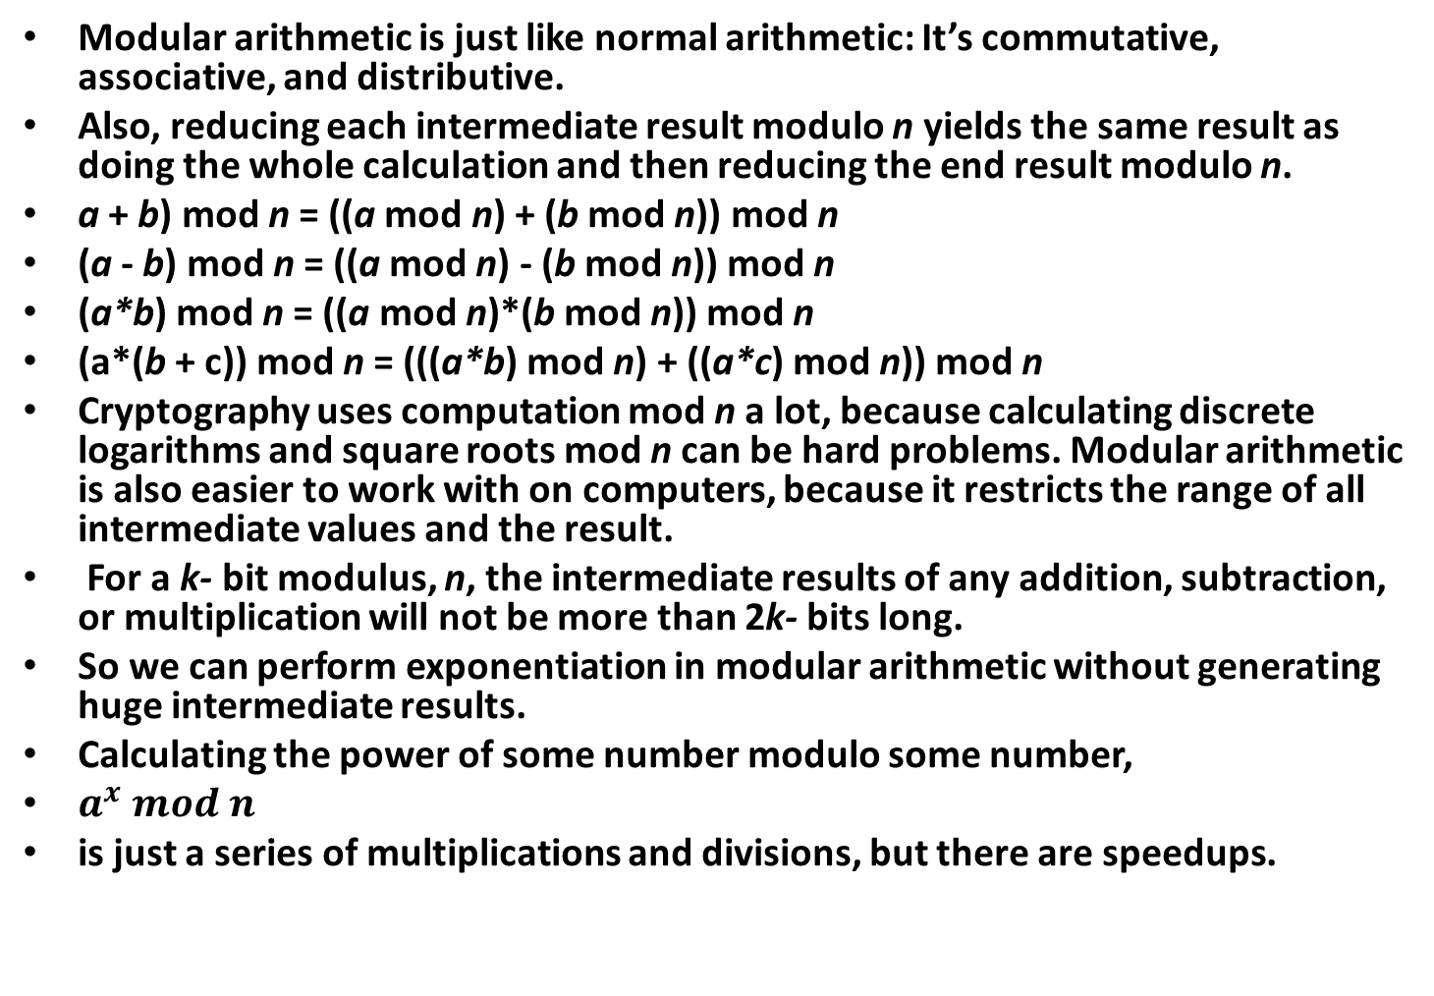
Modular Arithmatic conti…
Modular arithmetic is just like normal arithmetic: It’s commutative, associative, and distributive.
Also, reducing each intermediate result modulo n yields the same result as doing the whole calculation and then reducing the end result modulo n.
a + b) mod n = ((a mod n) + (b mod n)) mod n
(a - b) mod n = ((a mod n) - (b mod n)) mod n
(a*b) mod n = ((a mod n)*(b mod n)) mod n
(a*(b + c)) mod n = (((a*b) mod n) + ((a*c) mod n)) mod n
Cryptography uses computation mod n a lot, because calculating discrete logarithms and square roots mod n can be hard problems. Modular arithmetic is also easier to work with on computers, because it restricts the range of all intermediate values and the result.
For a k- bit modulus, n, the intermediate results of any addition, subtraction, or multiplication will not be more than 2k- bits long.
So we can perform exponentiation in modular arithmetic without generating huge intermediate results.
Calculating the power of some number modulo some number,
$a^{x} mod n$
is just a series of multiplications and divisions, but there are speedups.

Slide 19
Modular Arithmetic conti…
One kind of speedup aims to minimize the number of modular multiplications; another kind aims to optimize the individual modular multiplications. Because the operations are distributive, it is faster to do the exponentiation as a stream of successive multiplications, taking the modulus every time.
It doesn’t make much difference now, but it will when you’re working with 200-bit numbers.
For example, if you want to calculate a8 mod n, don’t use the naïve approach and perform seven
multiplications and one huge modular reduction:
(a*a*a*a*a*a*a*a) mod n
Instead, perform three smaller multiplications and three smaller modular reductions:
((a2 mod n)2 mod n)2 mod n

Slide 20
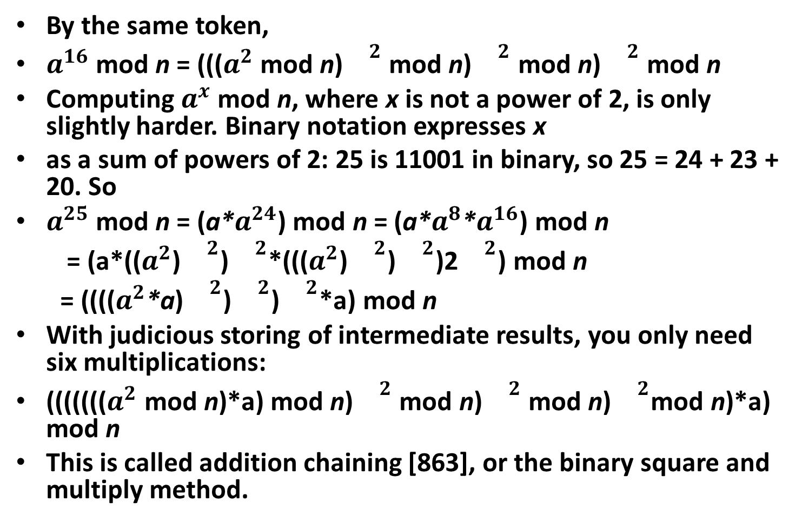
By the same token,
$a^{16}$ mod n = ((($a^{2}$ mod n)${}^{2}$ mod n)${}^{2}$ mod n)${}^{2}$ mod n
Computing $a^{x}$ mod n, where x is not a power of 2, is only slightly harder. Binary notation expresses x
as a sum of powers of 2: 25 is 11001 in binary, so 25 = 24 + 23 + 20. So
$a^{25}$ mod n = (a*$a^{24}$) mod n = (a*$a^{8}$*$a^{16}$) mod n
= (a*(($a^{2}$)${}^{2}$)${}^{2}$*((($a^{2}$)${}^{2}$)${}^{2}$)2${}^{2}$) mod n
= (((($a^{2}$*a)${}^{2}$)${}^{2}$)${}^{2}$*a) mod n
With judicious storing of intermediate results, you only need six multiplications:
((((((($a^{2}$ mod n)*a) mod n)${}^{2}$ mod n)${}^{2}$ mod n)${}^{2}$mod n)*a) mod n
This is called addition chaining [863], or the binary square and multiply method.

Slide 21
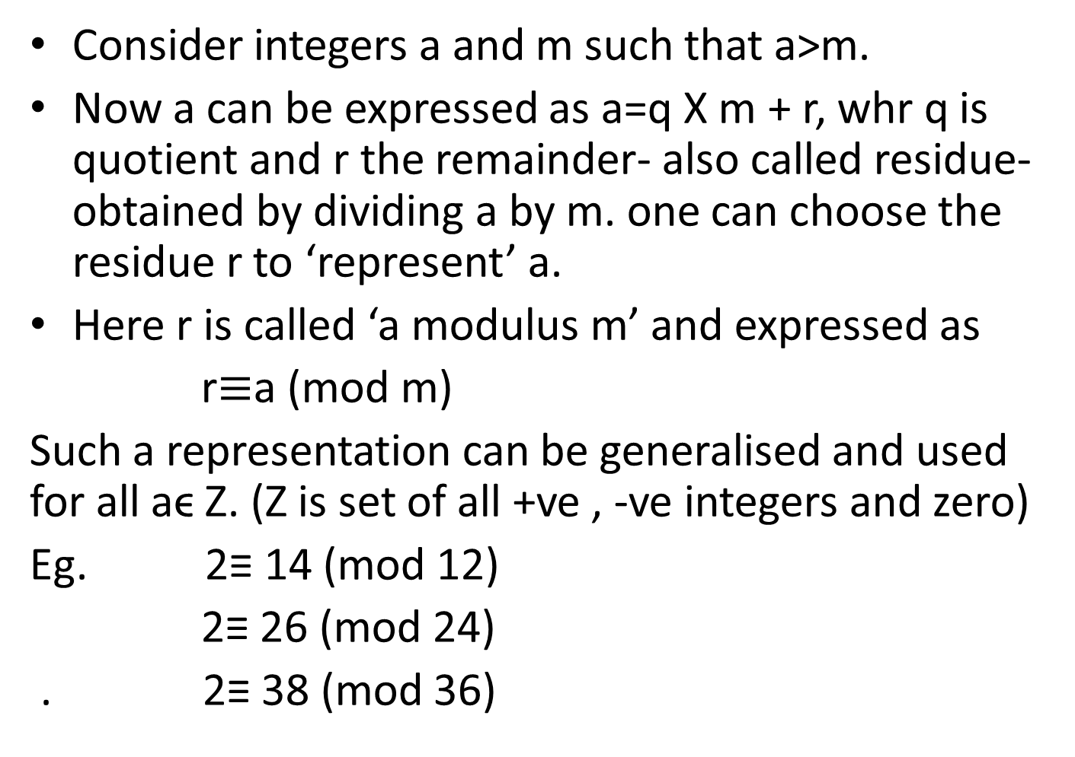
Modular Arithmatic conti
Consider integers a and m such that a>m.
Now a can be expressed as a=q X m + r, whr q is quotient and r the remainder- also called residue-obtained by dividing a by m. one can choose the residue r to ‘represent’ a.
Here r is called ‘a modulus m’ and expressed as
r$≡$a (mod m)
Such a representation can be generalised and used for all aϵ Z. (Z is set of all +ve , -ve integers and zero)
Eg. 2≡ 14 (mod 12)
2≡ 26 (mod 24)
. 2≡ 38 (mod 36)

Slide 22
Prime Numbers and GCD
Prime Numbers
A prime number is an integer greater than 1 whose only factors are 1 and itself: No other number evenly divides it.
Two is a prime number. So are 73, 2521, 2365347734339, and 2756839 - 1.
There are an infinite number of primes. Cryptography, especially public-key cryptography, uses large primes (512 bits and even larger) often.
Evangelos Kranakis wrote an excellent book on number theory, prime numbers, and their applications to cryptography
Greatest Common Divisor
Two numbers are relatively prime when they share no factors in common other than 1.
In other words, if the greatest common divisor of a and n is equal to 1. This is written:
gcd(a,n) = 1

Slide 23
GCD
The numbers 15 and 28 are relatively prime, 15 and 27 are not, and 13 and 500 are. A prime number
is relatively prime to all other numbers except its multiples.
One way to compute the greatest common divisor of two numbers is with Euclid’s algorithm . Euclid
described the algorithm in his book, Elements, written around 300 B.C. He didn’t invent it. Historians
believe the algorithm could be 200 years older. It is the oldest nontrivial algorithm that has survived
to the present day, and it is still a good one. Knuth describes the algorithm In C:

Slide 24
/* returns gcd of x and y */
int gcd (int x, int y)
{
int g;
if (x < 0)
x = -x;
if (y < 0)
y = -y;
if (x + y == 0)
ERROR;
g = y;
while (x > 0) {
g = x;
x = y % x;
y = g;
}
return g;
}

Slide 25
Euclidean Algorithm
The integers we dealt with in cryptography are much larger in size.
The factorization method of identifying the gcd of two numbers is too native to be practical.
The Euclidean Algorithm is well known and is widely used recursive procedure for getting the gcd of two integers.
Eg. Obtain gcd(80808, 31863)
the step by step procedure is as follows:
Divide the larger of the given integers by the smaller one to get the quotient and the remainder.

Slide 26
Thus the integer 80808 can be expressed as
80808 = 2 X 31863 + 17082
where 2 and 17082 are the quotient and the remainder, resp. Divide the second integer 31863 by remainder 17082 and express it in similar manner:
31863 = 1 X 17082 + 14781
Proceed in the same manner until remainder becomes zero; the corresponding sequence of equation is as follows:
17082 = 1 X 14781 + 2301
14781 = 6 X 2301 + 975
2301 = 2 X 975 + 351

Slide 27
Euclidean Algorithm from Shymla
975 = 2 X 351 + 273
351 = 1 X 273 + 78
273 = 3X 78 + 39
78 = 2 X 39 + 0
We stop at this stage with remainder being zero.
The previous remainder , 39 is desired gcd.
Generalizing for the set (a,b) with a > b, a can be expressed in terms of b as
a = q2 X b + r2
Where q2 and r2 are the quotient and remainder respectively.

Slide 28
Proceeding further in the same manner
b = q3 X r2 + r3
Where q3 and r3 are the quotient and remainder resp. obtained by dividing b by r2.
The procedure is continued until remainder becomes zero.
r2 = q4 X r3 + r4
R3 = q5 X r4 + r5
….
….
….
….

Slide 29
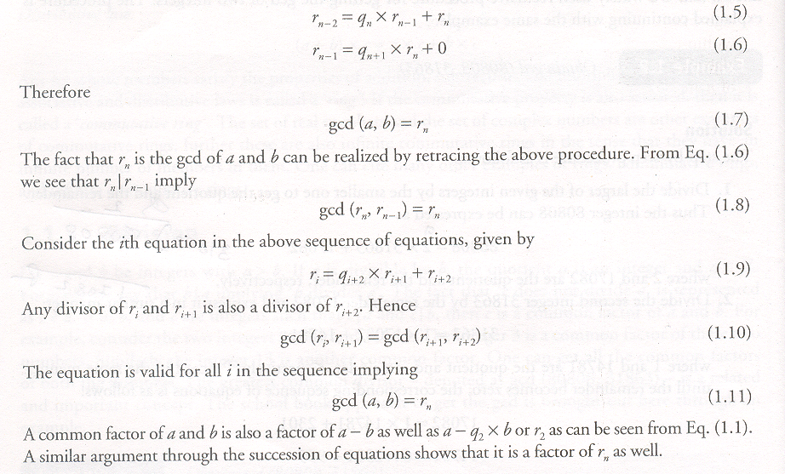

Slide 30
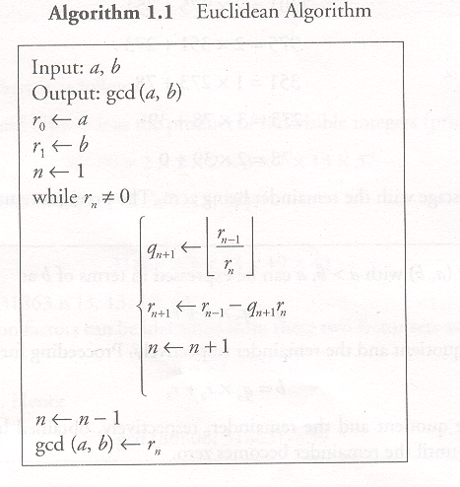

Slide 31
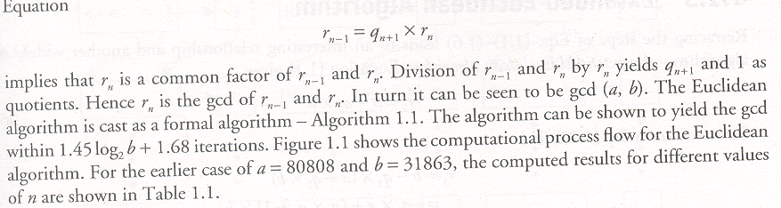

Slide 32
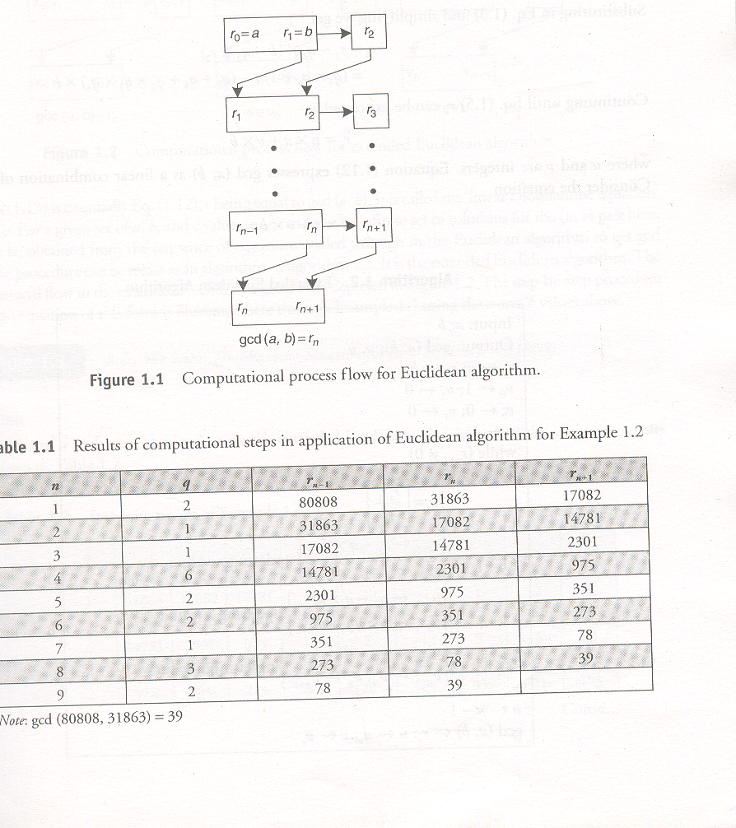

Slide 33
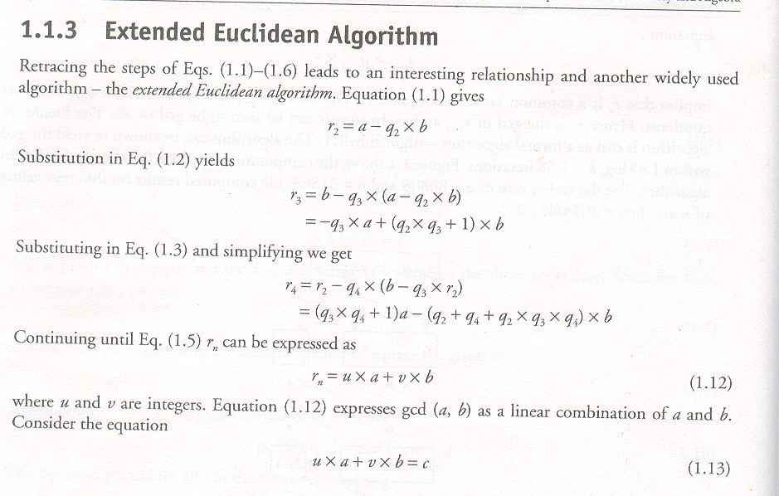

Slide 34
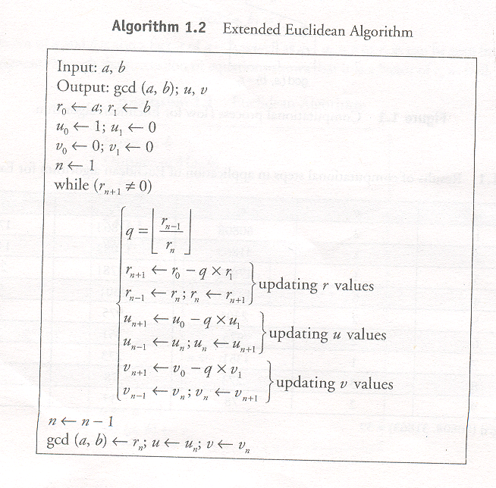

Slide 35
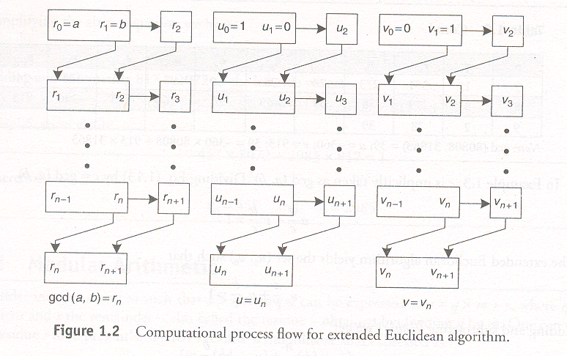
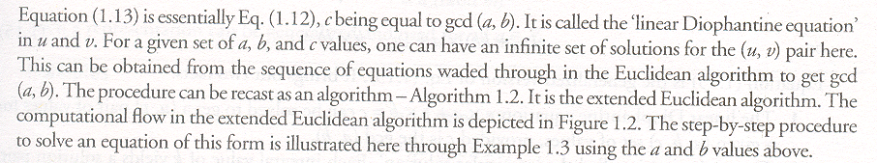

Slide 36
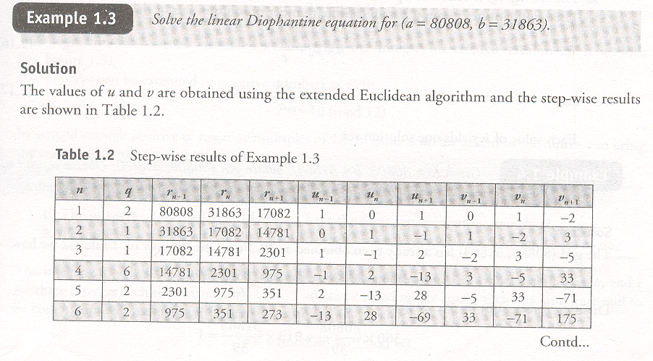

Slide 37
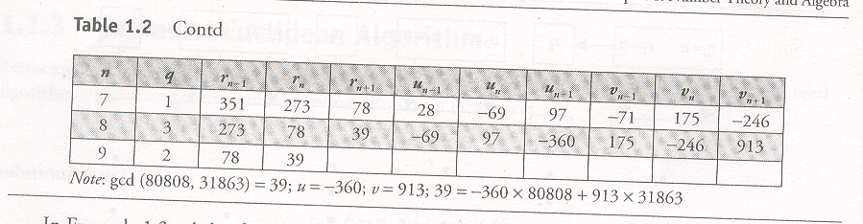

Slide 38
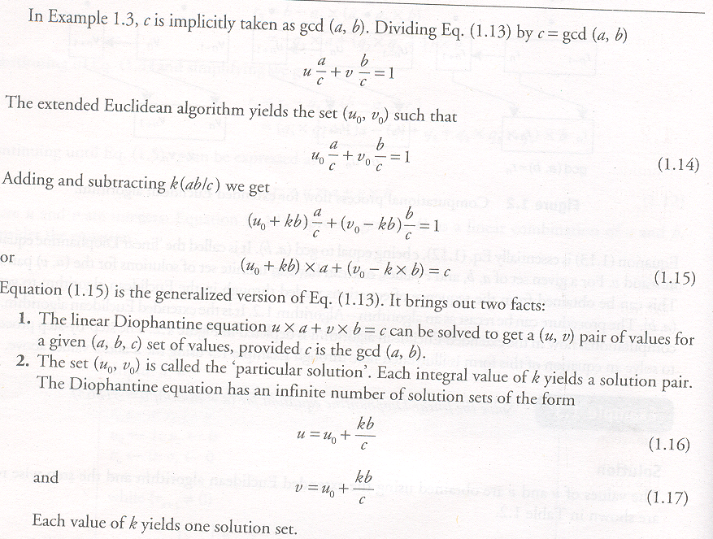

Slide 39
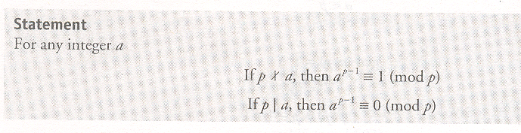
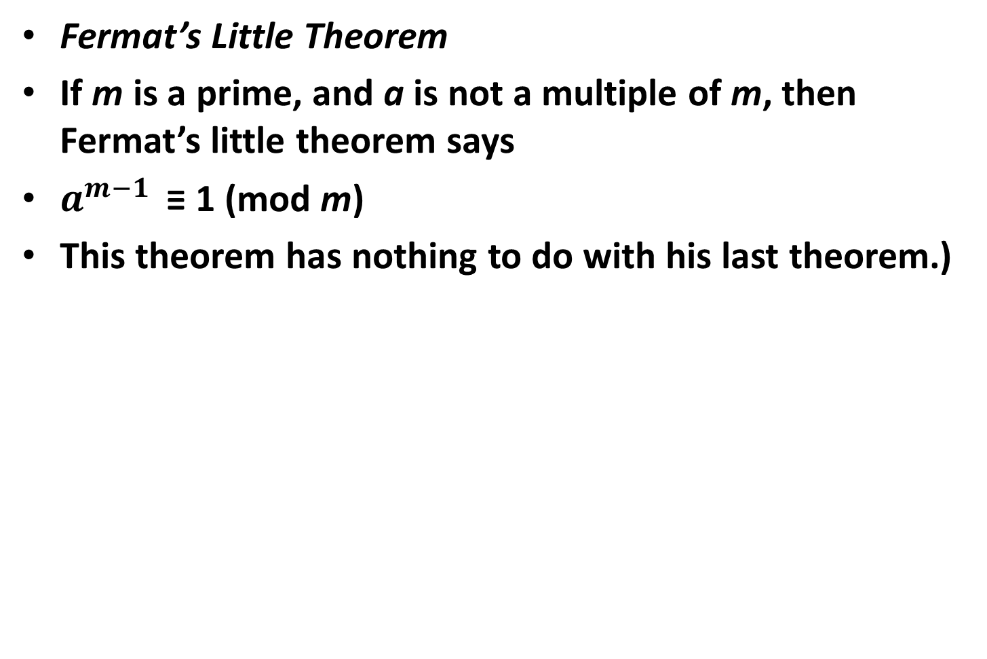
Fermat’s Little Theorem
Fermat’s Little Theorem
If m is a prime, and a is not a multiple of m, then Fermat’s little theorem says
$a^{m−1 }$ ≡ 1 (mod m)
This theorem has nothing to do with his last theorem.)

Slide 40
Chinese Remainder Theorem
If you know the prime factorization of n, then you can use something called the Chinese remainder theorem to solve a whole system of equations.
The basic version of this theorem was discovered by the first-century Chinese mathematician, Sun Tse.
In general, if the prime factorization of n is p1*p2*...*pt, then the system of equations
(x mod pi) = ai, where i = 1, 2,..., t
has a unique solution, x, where x is less than n. (Note that some primes can appear more than once.
For example, p1 might be equal to p2 .) In other words, a number (less than the product of some primes) is uniquely identified by its residues mod those primes.

Slide 41
The Chinese remainder theorem is a result about congruences in number theory and its generalizations in abstract algebra.
It was first published in the 3rd to 5th centuries by the Chinese mathematician Sun Tzu.
In its basic form, the Chinese remainder theorem will determine a number n that, when divided by some given divisors, leaves given remainders. For example, what is the lowest number n that when divided by 3 leaves a remainder of 2, when divided by 5 leaves a remainder of 3, and when divided by 7 leaves a remainder of 2?

Slide 42
Chinese Remainder Theorem conti..
For example, use 3 and 5 as primes, and 14 as the number. 14 mod 3 = 2, and 14 mod 5 = 4. There is
only one number less than 3*5 = 15 which has those residues: 14. The two residues uniquely
determine the number.
So, for an arbitrary a < p and b < q (where p and q are prime), there exists a unique x, where x is less
than pq, such that
x≡ a (mod p), and x≡ b (mod q)
To find this x, first use Euclid’s algorithm to find u, such that
u*q ≡ 1 (mod p)
Then compute:
x = (((a - b)*u) mod p)*q + b

Slide 43
Modular Arithmetic
A logarithm is the power to which a number must be raised in order to get some other number (see Section 3 of this Math Review for more about exponents). For example, the base ten logarithm of 100 is 2, because ten raised to the power of two is 100:
log 100 = 2
because
10² = 100
This is an example of a base-ten logarithm. We call it a base ten logarithm because ten is the number that is raised to a power. The base unit is the number being raised to a power. There are logarithms using different base units. If you wanted, you could use two as a base unit. For instance, the base two logarithm of eight is three, because two raised to the power of three equals eight:
log₂ 8 = 3
because
2³ = 8

Slide 44
In general, you write log followed by the base number as a subscript. The most common logarithms are base 10 logarithms and natural logarithms; they have special notations. A base ten log is written
log
and a base ten logarithmic equation is usually written in the form:
log a = r
A natural logarithm is written
ln
and a natural logarithmic equation is usually written in the form:
ln a = r
So, when you see log by itself, it means base ten log. When you see ln, it means natural logarithm .In this course only base ten and natural logarithms will be used.

